Slide 1
BRIGHTTV · CUSTOMER VALUE MANAGEMENT
Viewership Analytics
End-to-End Business Intelligence Solution
Growing the subscriber base and deepening engagement through evidence, not instinct.
PRESENTED BY
ROLE
DATE
Mashudu Sivhada
Data Analyst · Business Intelligence
July 2026
Executive Briefing · Board Level
Notes:
Good morning. Over the next twenty minutes I will walk the executive team through the BrightTV Viewership Analytics programme: what the Customer Value Management team was asked to solve, how we built an end-to-end analytics pipeline over 9,980 viewing sessions, what the data tells us about our audience, and the four decisions I am asking this room to make today.

Slide 2
SLIDE 02
Executive Summary
01
02
03
04
Business Problem
Approach
Key Findings
Business Value
Leadership lacked a single, trusted view of who watches BrightTV, when, and for how long — so subscriber growth and retention decisions were made on instinct.
SQL engineering over 9,980 viewing sessions joined to user profiles, feature-engineered into an analytical dataset and surfaced through Excel, Power BI, Looker Studio and a live Lovable app.
Sessions grew 119% Jan→Mar. Sport drives 41% of viewing. 88% of viewers are male, 41% Early Adults, 37% Gauteng. Average session is only 9.2 minutes.
A repeatable insight engine plus four prioritised interventions targeting session length, audience diversification and content concentration risk.
The ask: approve a sport-anchored retention play, a female and youth acquisition push, and a move from descriptive to predictive analytics in FY27.
BrightTV | Viewership Analytics
01
Notes:
Four things to hold on to. One: growth is real — sessions grew 119% from January to March. Two: that growth is dangerously concentrated — sport alone is 41% of all viewing. Three: our audience is narrow — 88% male, 41% Early Adults, 37% Gauteng. Four: engagement is shallow — the average session is nine minutes and 69% of profiles fall in the No Usage screen-time bracket. The upside is that every one of those is addressable, and the recommendations later in this deck quantify how.

Slide 3
SLIDE 03
The Business Problem
CURRENT CHALLENGE
Questions We Had to Answer
Viewership data sat unmodelled across raw session logs and user profiles. No shared definitions, no engagement baseline, no segment view — and therefore no defensible growth strategy.
Which channels command the most watch time — and which hold attention longest?
When are our viewers actually available to watch?
Who is watching, and who is missing from the audience?
Where is engagement leaking away?
Business Objectives
Expected Outcomes
Grow the paying subscriber base
Increase engagement per viewing session
Retain high-value, high-frequency viewers
Target content and marketing spend with evidence
A single trusted analytical dataset
Executive dashboards across four platforms
Prioritised, costed business recommendations
A repeatable monthly reporting rhythm
BrightTV | Viewership Analytics
02
Notes:
BrightTV is spending against a picture of its audience that nobody can verify. The CEO set a clear objective — grow subscribers and engagement — but the CVM team could not answer basic questions: which channels actually hold attention, when our viewers are available, and which segments we are failing to reach. This slide frames the four questions the analysis had to answer and the outcomes we committed to.

Slide 4
SLIDE 04
Project Scope
1
Business Understanding
2
Data Collection
3
Data Cleaning
Framed the CEO growth mandate into measurable analytical questions with the CVM team.
Consolidated user profile records and viewership session logs into one working environment.
Standardised province, race and gender values, resolved nulls, removed invalid sessions.
4
Feature Engineering
5
Dashboard Development
6
Business Recommendations
Derived age groups, time-of-day bands, duration, day classification and screen-time brackets.
Built Excel, Power BI, Looker Studio and a live interactive Lovable analytics app.
Translated findings into prioritised, owner-assigned commercial actions.
BrightTV | Viewership Analytics
03
Notes:
Six workstreams, delivered end to end by a single analyst. I want to draw your attention to the middle two — cleaning and feature engineering. Roughly 60% of the effort sat there, and that is where the analytical value was created: without standardised provinces, age bands and time-of-day buckets, none of the downstream dashboards would be comparable.

Slide 5
SLIDE 05
Project Timeline
Week 1
Week 3
Week 5
Week 7
Week 9
Business Understanding
Data Collection
SQL Cleaning & Standardisation
Feature Engineering
Dashboard Development
Insights & Recommendations
Milestones: analytical dataset signed off · four dashboards live · executive board readout
BrightTV | Viewership Analytics
04
Notes:
The programme ran across six phases. Data cleaning and feature engineering deliberately overlap — cleaning surfaced the quality issues that shaped the features we built. Dashboard development was the longest single phase because we delivered four platforms, each for a different audience: analysts in Excel, management in Power BI, stakeholders in Looker, and executives in the live web app.

Slide 6
SLIDE 06
Data Sources
User Profiles
THE ANALYTICAL DATASET
Gender · Race · Age → age group · Province · Contact flags
Demographic attributes per subscriber
9,980
Viewing sessions
Viewership Sessions
Channel · Date & hour · Duration in minutes · Day of week
1,522
Session-level consumption events
Total viewing hours
16
Business Case
Objectives · Success measures · Questions to answer
Distinct channels
CVM growth mandate from the CEO
Jan–Mar
Dashboards
Observation window
Excel · Power BI · Looker Studio · Lovable web app
14
Delivery layer and feedback loop
Engineered attributes
BrightTV | Viewership Analytics
05
Notes:
Four inputs. The two that matter analytically are user profiles and viewership sessions — joined, they give us 9,980 rows covering January to March. The business case document kept the analysis anchored to commercial questions rather than curiosity, and the dashboards are both an output and, increasingly, a source of feedback on what executives actually ask for.

Slide 7
SLIDE 07
Technology Stack
DATA ENGINEERING
ANALYTICS & VISUALISATION
DELIVERY & COLLABORATION
SQ
SQL
EX
Excel
PO
PowerPoint
Cleaning, joins, aggregation
Analyst-level pivot dashboard
Executive storytelling
DA
Databricks
PO
Power BI
CA
Canva
Scaled processing environment
Management reporting
Visual design assets
LO
Looker Studio
MI
Miro
Stakeholder self-service
Solution architecture
LO
Lovable
GI
GitHub
Live interactive web app
Version control & documentation
BrightTV | Viewership Analytics
06
Notes:
A deliberately pragmatic stack. SQL and Databricks do the heavy engineering; Excel, Power BI, Looker and Lovable each serve a different consumer of the insight; and Miro, Canva, PowerPoint and GitHub carry the thinking, the storytelling and the version control. Nothing here requires new licensing — this is buildable inside our current estate.

Slide 8
SLIDE 08
Analytics Workflow
01 INGEST & ENGINEER
02 SERVE
03 DECIDE
Business Case
Excel Dashboard
Business Insights
Raw Data
Power BI
SQL Cleaning
Looker Studio
Recommendations
Feature Engineering
Lovable Web App
Growth · Engagement · Retention
Analytical Dataset · 9,980 rows
One certified source feeds every consumption layer
BrightTV | Viewership Analytics
07
Notes:
This is the architecture end to end. Read it left to right in three zones: ingest and engineer, then serve through four consumption layers, then convert into insight and action. The critical design decision was the single analytical dataset in the middle — every dashboard reads from the same certified table, which is why the numbers agree wherever an executive looks.

Slide 9
SLIDE 09
SQL Data Engineering
Cleaning
Nulls, blanks and invalid session durations resolved
REPRESENTATIVE TRANSFORMATION
SELECT
v.user_id,
INITCAP(TRIM(u.province)) AS province,
LOWER(TRIM(u.race)) AS race,
CASE
WHEN u.age < 20 THEN 'Children & Teens'
WHEN u.age < 30 THEN 'Young Adults'
WHEN u.age < 40 THEN 'Early Adults'
WHEN u.age < 50 THEN 'Mid-Career Adults'
WHEN u.age < 60 THEN 'Mature Adults'
ELSE 'Seniors'
END AS age_group,
CASE
WHEN HOUR(v.start_ts) BETWEEN 12 AND 14
THEN '06. Afternoon'
WHEN HOUR(v.start_ts) BETWEEN 15 AND 17
THEN '07. Dusk'
...
END AS time_of_day,
DATEDIFF(MINUTE, v.start_ts, v.end_ts)
AS duration_minutes
FROM viewership v
JOIN user_profiles u ON u.user_id = v.user_id
WHERE v.end_ts > v.start_ts;
Standardisation
Province, race and gender values normalised to one taxonomy
Feature Engineering
Age groups, time-of-day bands, day classification
Joins
User profiles joined to session logs on user key
Aggregations
Watch time and session counts by channel, segment, period
Derived Columns
Duration in minutes, screen-time brackets, contact flags
BrightTV | Viewership Analytics
08
Notes:
This is where the trust in every later number is created. Six operations: cleaning, standardisation, feature engineering, joins, aggregation and derived columns. The snippet on the right is representative — we standardise dirty province and race values, band age into commercial segments, and bucket the hour of day into eleven viewing periods. Every transformation is version-controlled in GitHub and reproducible.

Slide 10
SLIDE 10
Feature Engineering
Age Groups
Province
Time of Day
Duration
6 commercial bands from raw age
9 provinces + Uncategorized
11 ordered viewing periods
Session length in minutes
Early Adults = 41% of sessions
Gauteng = 37% of sessions
Afternoon peak = 1,904 sessions
Average 9.2 min per session
Email Flag
Social Media Flag
Screen-Time Brackets
14
Contactability by email
Reachability on social
No / Low / Mid / High usage
modelled attributes now available to every dashboard from one certified table.
100% contactable
100% reachable
69% sit in No Usage
BrightTV | Viewership Analytics
09
Notes:
Seven engineered features turned raw logs into commercial language. Age groups gave us marketable segments. Time-of-day bands revealed the afternoon peak. Screen-time brackets exposed the engagement problem — 69% of profiles sit in No Usage. These are the columns the business now speaks in.

Slide 11
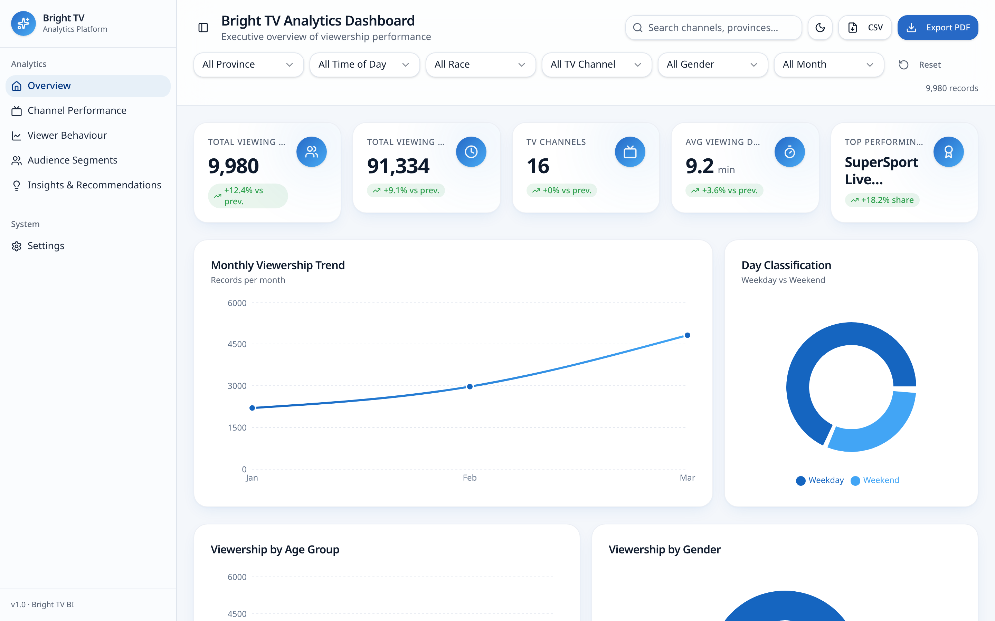
SLIDE 11
Dashboard Overview
Lovable — live interactive analytics app
lumina-tv-analytics.lovable.app
BrightTV | Viewership Analytics
10
Notes:
Four delivery layers, one dataset. Excel serves the analyst community, Power BI serves management reporting, Looker Studio gives stakeholders self-service, and the Lovable web app is what you are seeing live today — filterable, responsive and shareable by link. The screenshots on the left are from the live application; the Excel, Power BI and Looker captures need to be dropped into the marked frames before the board session.

Slide 12
SLIDE 12
Executive KPI Dashboard
TOTAL VIEWING RECORDS
TOTAL VIEWING HOURS
AVG SESSION DURATION
ACTIVE CHANNELS
SUBSCRIBERS
9,980
1,522
9.2 min
16
4386
Jan–Mar observation window
91,334 minutes watched
Engagement baseline
1 dominates at 27%
Source: billing system
Monthly momentum — sessions grew 119% from January to March
WHAT THE KPIs SAY
Demand is accelerating — March alone carried 48% of quarterly sessions.
Volume growth is not matched by depth: sessions remain ~9 minutes.
69% of profiles fall in the No Usage screen-time bracket.
Growth is therefore acquisition-led, not engagement-led.
BrightTV | Viewership Analytics
11
Notes:
Five numbers define the business today. Nine thousand nine hundred and eighty sessions across sixteen channels, totalling just over fifteen hundred viewing hours. The number I want you to sit with is the average session: 9.2 minutes. That is not appointment viewing — that is sampling. Everything downstream in this deck is about converting samplers into subscribers. Note that the subscriber count is not in the session dataset and needs to come from the billing system.

Slide 13
SLIDE 13
Channel Performance
Top channels by sessions
Average session duration (minutes)
Concentration risk
Attention leaders
Recommendation
Sport = 41% of all sessions and 421 of 1,522 watch hours. A lost rights deal would remove roughly two-fifths of consumption overnight.
MK (16.3 min) and SawSee (12.3 min) hold viewers ~40% longer than the portfolio average but carry under 4% of sessions.
Promote high-retention titles into sport adjacency slots and surface them in the recommendation rail post-match.
BrightTV | Viewership Analytics
12
Notes:
Sport is the franchise. SuperSport and the ICC Cricket World Cup together account for 41% of all sessions and 42% of watch time. But look at the right-hand chart — the channels that hold attention longest are not the ones with the most volume. MK averages 16 minutes and SawSee 12 minutes against a 9.2 minute baseline. That gap is a programming and recommendation opportunity we are currently leaving on the table.

Slide 14
SLIDE 14
Viewer Behaviour
Sessions by hour of day
Sessions by time-of-day band
Weekday vs weekend split
Monthly trend
Peak windows
Jan 2,199 → Feb 2,967 → Mar 4,814 sessions
March carried 48% of the quarter
Growth is volume-led, not depth-led
Plateau from 10:00 to 19:00
Saturday strongest day (1,652)
Post-21:00 demand falls ~70%
BrightTV | Viewership Analytics
13
Notes:
Three behavioural facts. First, viewing peaks in the afternoon and holds through dusk and twilight — not the traditional prime-time evening slot. Second, 69% of sessions land on weekdays, with Saturday the single strongest day. Third, hourly demand plateaus from 10am to 7pm and collapses after 9pm. Our scheduling and campaign send-times should follow this curve, and today they do not.

Slide 15
SLIDE 15
Audience Segmentation
Gender
Age group
Race
Province
WHERE THE HEADROOM IS
Women are 9.8% of viewing. Under-20s are 5.4%. Six provinces together carry less than a third of sessions. These are the three underserved pools our growth targets should be written against.
BrightTV | Viewership Analytics
14
Notes:
This is the most commercially uncomfortable slide in the deck. Eighty-eight percent of our viewing is male. Forty-one percent is a single age band. Thirty-seven percent is one province. We are not serving a national audience — we are serving a narrow one extremely well. Each of those concentrations is simultaneously a risk and the clearest growth headroom we have.

Slide 16
SLIDE 16
Business Insights
01
Sport carries the business
02
Engagement is shallow
WHAT HAPPENED
SuperSport and the ICC Cricket World Cup drive 41% of sessions and 42% of watch hours.
WHAT HAPPENED
Average session is 9.2 minutes and 69% of profiles sit in the No Usage screen-time bracket.
WHY
Live sport is appointment content in a market where everything else is on-demand and substitutable.
WHY
Viewers sample rather than settle — discovery is weak and there is no next-title continuation.
BUSINESS IMPACT
A single rights loss removes ~2 in 5 viewing sessions. Concentration is our largest unhedged risk.
BUSINESS IMPACT
Low session depth suppresses ad inventory value and is the leading indicator of subscriber churn.
03
The audience is narrow
04
Demand is afternoon-shaped
WHAT HAPPENED
88% male, 41% Early Adults, 37% Gauteng. Women contribute under 10% of sessions.
WHAT HAPPENED
Viewing peaks in the afternoon and holds to twilight; 69% of sessions are weekdays.
WHY
Content mix and marketing have optimised for the segment that already converts most easily.
WHY
Consumption follows daytime availability, not traditional evening prime-time assumptions.
BUSINESS IMPACT
Three large underserved pools — women, under-20s and non-metro provinces — are growth headroom.
BUSINESS IMPACT
Scheduling and campaign send-times aligned to the 10:00–19:00 plateau lift reach at zero media cost.
BrightTV | Viewership Analytics
15
Notes:
Four insight cards, each structured the same way: what happened, why it happened, and what it costs or earns us. I would spend the most time on the second — shallow engagement. A 9.2 minute average session against 69% of profiles in No Usage tells us our churn risk is not in the future, it is already present in the behaviour.

Slide 17
SLIDE 17
Recommendations
HIGH IMPACT · THIS QUARTER
MEDIUM IMPACT · NEXT QUARTER
FUTURE OPPORTUNITY · FY27
Sport-anchored retention play
Underserved audience acquisition
Predictive engagement engine
Sequence high-retention titles (MK, SawSee, Africa Magic) into post-match rails to convert the 41% sport audience into multi-genre viewers.
Targeted acquisition for women (9.8% of viewing) and under-20s (5.4%) with a dedicated content slate and creative.
Churn propensity and next-best-title models feeding a personalised recommendation rail across the estate.
Owner: Content & CVM
Owner: Marketing & CVM
Owner: Data & Engineering
Metric: avg session 9.2 → 12 min
Metric: female share 9.8% → 18%
Metric: churn model AUC > 0.75
Afternoon-first scheduling
Re-weight premieres and campaign send-times to the 10:00–19:00 demand plateau and Saturday peak.
Owner: Scheduling & Marketing
Metric: +15% weekday reach
Decision requested today: approve the two high-impact plays for immediate execution and mandate a FY27 business case for the predictive engine.
BrightTV | Viewership Analytics
16
Notes:
Four moves, prioritised by impact and effort. The two high-impact plays are deliverable this quarter with existing capability. Medium impact needs marketing alignment. The future opportunity is the predictive layer, which is a FY27 investment conversation. Each has a named owner and a measurable success metric — I am asking for approval on the first two today.

Slide 18
SLIDE 18
Future Roadmap
HORIZON 1
HORIZON 2
HORIZON 3
Now
6–12 months
12–24 months
Descriptive analytics
Predictive analytics
Intelligent platform
Certified analytical dataset
Four executive dashboards
Monthly reporting rhythm
Churn propensity modelling
Engagement forecasting
Segment-level demand models
Recommendation engine
Machine learning in production
Azure cloud + real-time dashboards
BrightTV | Viewership Analytics
17
Notes:
A three-horizon path from descriptive to prescriptive analytics. We are at the end of horizon one. Horizon two — predictive models and a recommendation engine — is where the session-length problem gets solved at scale. Horizon three moves us onto Azure with real-time dashboards, which is what an operator of our ambition should run on.

Slide 19
SLIDE 19
Project Achievements
Business Skills
Technical Skills
Dashboard Development
Translated a CEO growth mandate into measurable analytical questions and costed, owner-assigned recommendations.
SQL engineering across 9,980 records — cleaning, joins, aggregation and 14 engineered attributes.
Four production dashboards: Excel, Power BI, Looker Studio and a live interactive web application.
SQL Engineering
Data Storytelling
End to end
A reproducible, version-controlled transformation layer producing one certified analytical dataset.
A boardroom narrative that moves from evidence to insight to decision in under twenty minutes.
From raw session logs to a board-level decision, delivered as one continuous analytics capability.
BrightTV | Viewership Analytics
18
Notes:
What the programme proved beyond the findings themselves: that we can take a raw commercial question, engineer trustworthy data against it, and deliver decision-ready insight across four platforms in a single cycle. That capability is now in-house and repeatable.

Slide 20
SLIDE 20
Lessons Learned
CHALLENGE
SOLUTION
KEY LEARNING
Data quality was the project
Built an explicit standardisation layer in SQL and surfaced an Uncategorized bucket rather than silently dropping rows.
Quality issues must be visible in the dashboard, not hidden by the pipeline.
1,168 records with unknown race, 262 with no province, inconsistent gender values.
Four dashboards, one truth
Centralised every metric definition in the analytical dataset before any visual was built.
Governance of definitions matters more than choice of BI tool.
Early prototypes disagreed because each tool applied its own filters and definitions.
Executives buy decisions
Restructured every insight into what happened, why, and business impact, ending in a prioritised ask.
Analysis only creates value at the point it changes a decision.
The first draft was chart-rich and decision-poor — interesting, but not actionable.
BrightTV | Viewership Analytics
19
Notes:
Three honest lessons. Data quality was the real project — over a thousand records carried unknown race and 262 had no province. Second, dashboards multiply only if they share one dataset, otherwise they multiply arguments. Third, executives do not want charts, they want decisions, so every visual in this deck earns its place by supporting a recommendation.

Slide 21
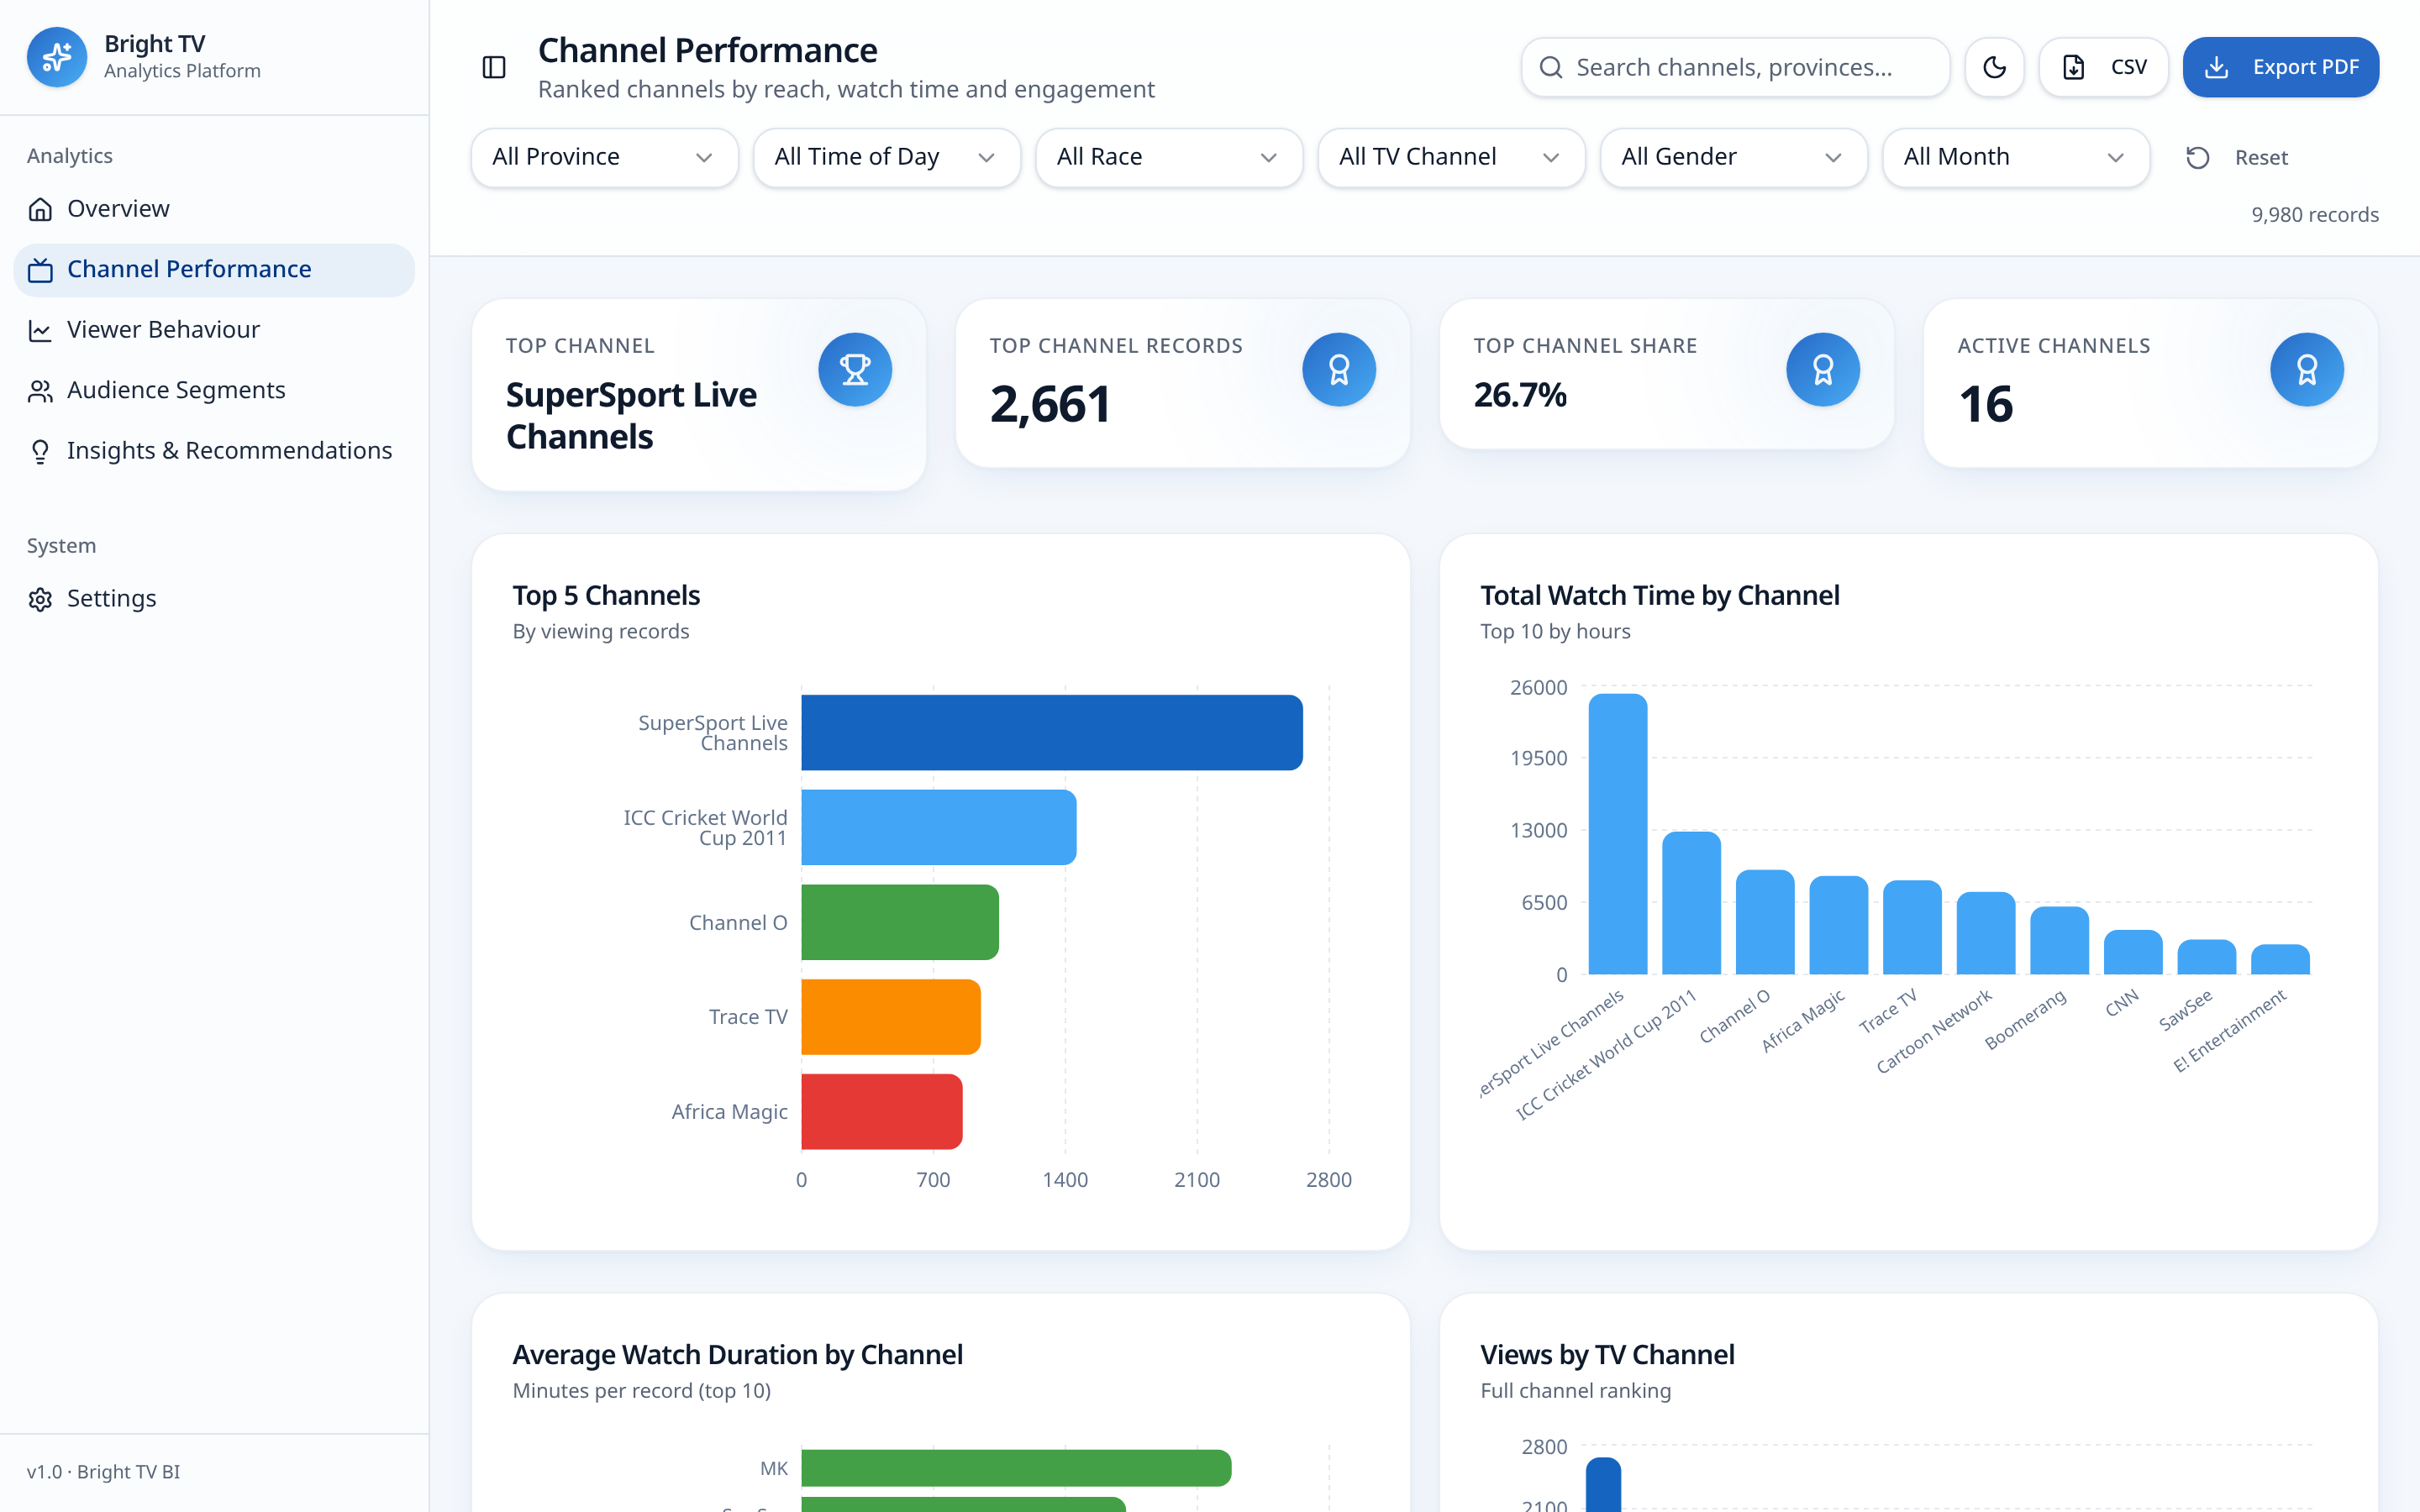

SLIDE 21
Live Dashboard
SCAN TO EXPLORE
lumina-tv-analytics.lovable.app
Six live cross-filters
Five analytical pages
Real 9,980-row dataset
Dark mode, CSV and PDF export
BrightTV | Viewership Analytics
20
Notes:
This is live, not a screenshot. Scan the code and you can filter the full dataset by province, channel, gender, race, time of day and month, and every KPI and chart on the page recalculates instantly. It is the same certified data behind everything you have seen today, and it is shareable by link across the leadership team.

Slide 22
SLIDE 22
Conclusion
BUSINESS VALUE
RECOMMENDATIONS
FUTURE VISION
One certified analytical dataset, four executive dashboards and a repeatable monthly rhythm — replacing instinct with evidence across the CVM function.
A sport-anchored retention play and afternoon-first scheduling this quarter; underserved audience acquisition next quarter.
Predictive engagement, a recommendation engine and real-time cloud dashboards moving BrightTV from reporting to anticipating.
9,980 sessions analysed. Four dashboards delivered. Four decisions on the table.
Approve the two high-impact plays today and BrightTV begins converting samplers into subscribers this quarter.
BrightTV | Viewership Analytics
21
Notes:
To close. We now have one trusted view of viewership, and it says three things: demand is growing, engagement is shallow, and the audience is narrower than our ambition. The two high-impact plays address the first two this quarter. The predictive roadmap addresses the third structurally. With your approval today, we start executing next week.

Slide 23
Questions
Thank you
BrightTV · Customer Value Management · lumina-tv-analytics.lovable.app
Notes:
Thank you. I am happy to take questions on the methodology, the data quality caveats, or the commercial assumptions behind the recommendations. The live dashboard is available now if anyone would like to interrogate a specific segment.

